Slide 1
AUTOMATIC DOCUMENT CLASSIFIER
NABEEL E P
35
PRODUCT OWNER-Mr. MUHAMMED JABIR

Slide 2
TABLE OF CONTENTS
Introduction
Modules
Methodology
Data Flow Diagram
Table Design
Developing Environment
Future Enhancements
Project Plan
User Story
Product Backlog
Sprint Plans
Sprint Actual

Slide 3
INTRODUCTION
The classification is a grouping procedure which allows us to group a set of data according to a selected criterion. Generally, the objects or data of the same group share similar characteristics with one another, while the objects of different groups will have less similarity among them. For example, in an organization the documents can be classified by a functional criterion, that is to say, grouping the documents by activities inside the company, or through a criterion of hierarchical order, where the managers have access to different documents that employees have access to. The goal in the task of classification is to locate the document of an appropriate class.
Having a large number of features makes the classification process to be computationally expensive and that the classes not being well defined. The feature selection focuses on reducing the dimensionality, many approaches concentrate on considering only one subset of features extracted from text. Generally, for the selection of characteristics we have techniques based in the collection of documents and techniques based in typifying each class by using Genetic algorithm

Slide 4
MODULES
Admin
Verify the user.
Reply to messages.
Add datasets.
User
Send and receive messages.
Upload documents.
View category.
Identify duplicate documents.
View history.
Display documents under different categories.

Slide 5
METHODOLOGY
A website provides a login page where both user and admin can login and also there exist a option for new users to signup
Admin login by user id and password and they can verify users who are registered recently . Also they can replay to the messages and adding data sets working based on genetic algorithm
User can login by username and password ,and they can send message to admin,upload documents, and they can view documents under different category.

Slide 6
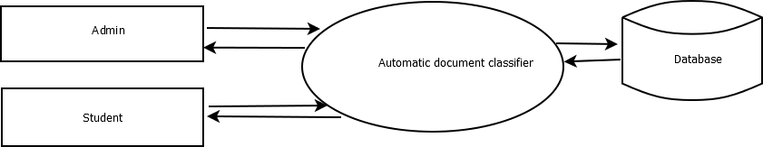
Level 0

Slide 7
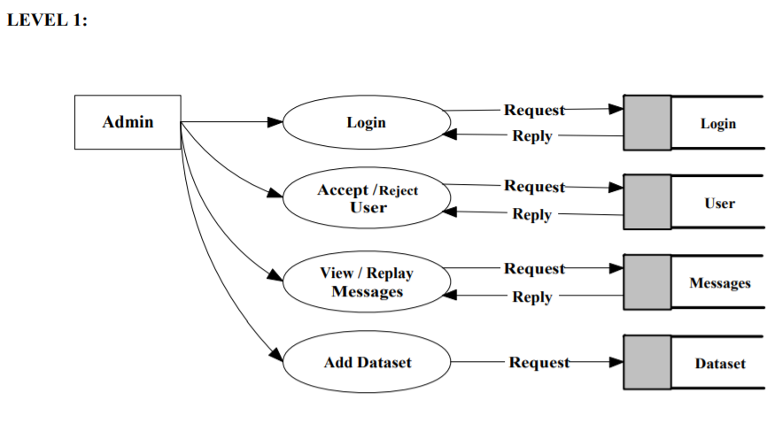

Slide 8
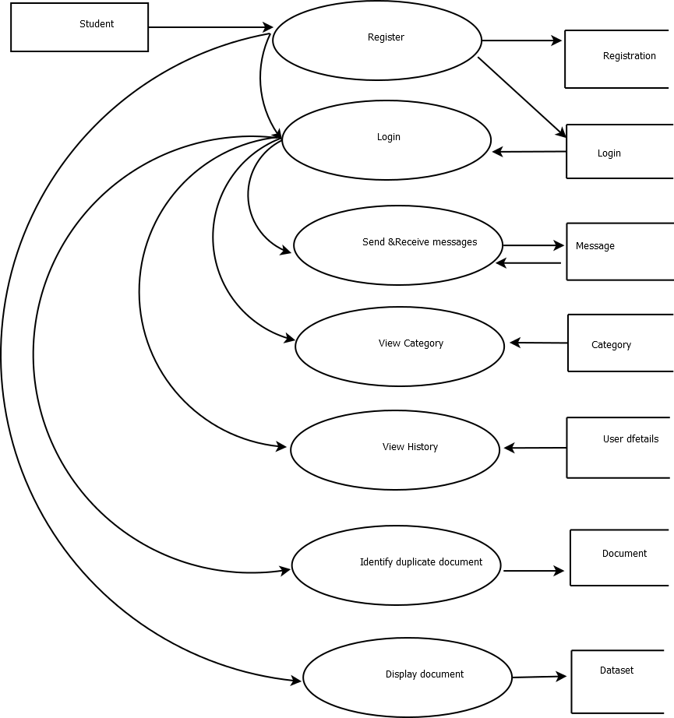
Level 2

Slide 9
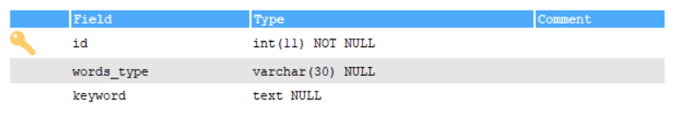
Login
Dataset

Slide 10
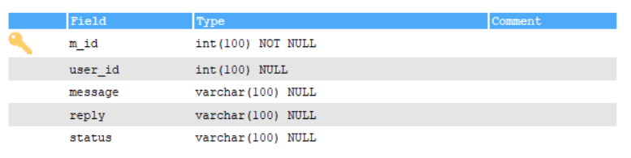
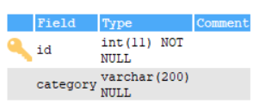
Massages
Category

Slide 11
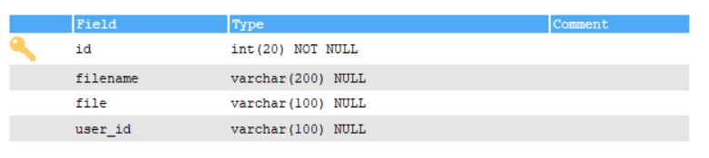
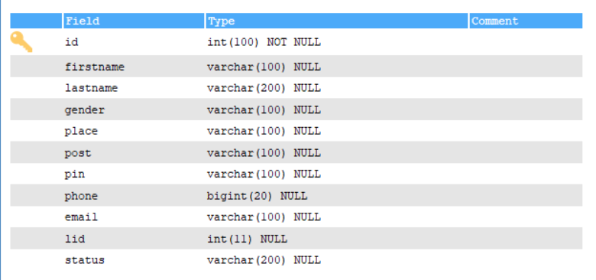
Documents
User Details

Slide 12
DEVELOPING ENVIRONMENT
Hardware Requirements
Input Device : Mouse, Keyboard
Output Device : Monitor
Memory : 4 Gb Ram(Minimum)
Processor : Intel core i3 or above
Software Requirements
Operating System : Windows 8 /10 for Better Performance
Front End : Python (Flask)
Back End : MySql
Software Used : Pycharm
Web Browser :Internet Explorer/Google Chrome/Firefox(for web application)

Slide 13
Future Enhancement
In future scan text from image and predict that image belongs in which category
Improved UI
In future there will be an app works in both android and ios
Improved data set
In future it can classify most type of documents

Slide 14
PROJECT PLAN
User Story ID | Task Name | Start Date | End Date | Days | Status
1 | Sprint 1 | 26/12/2021 | 28/12/2021 | 2 | Completed
2 |  | 29/12/2021 | 31/12/2021 | 3 | Completed
3 |  | 03/12/2021 | 08/01/2022 | 5 | Completed
4 | Sprint 2 | 09/01/2022 | 16/01/2022 | 8 | Completed
5 |  | 18/01/2022 | 22/01/2022 | 5 | Completed
6 | Sprint 3 | 23/01/2022 | 27/01/2022 | 5 | Completed
7 |  | 30/01/2022 | 05/02/2022 | 7 | Completed
8 | Sprint 4 | 06/02/2022 | 10/01/2022 | 5 | Completed
9 |  | 16/02/2022 | 19/02/2022 | 4 | Completed

Slide 15
USER STORIES
User StoryID | As a <type of user> | I want to | So that I can
1 | Admin | login | login successful with correct username and password
2 | Admin | View users | view users
3 | Admin | verify users | accept and reject users
4 | Admin | Reply to messages | Replay to messages from Users
5 | User | login | login successful with correct username and password
6 | User | Send and receive messages | User can send messages to admin
7 | User | Upload documents | User can upload documents to classify
8 | User | View category | User can view category
9 | User | Duplicate documents | User can view duplicate documents
10 | User | View history | User can view history of uploaded documents
11 | User | Display documents | Display documents under different category
12
13
14
15
16
17 | Patient | View claim status | View status of request

Slide 16
PRODUCT BACKLOG
User Story ID | Priority <High/Medium/Low> | Size (Hours) | Sprint <#> | Status <Planned/In progress/Completed> | Release Date | Release Goal
1 | Medium | 2 | 1 | Completed |  | Table design
2 | High | 3 |  | Completed |  | Form design
3 | High | 5 |  | Completed |  | Basic coding
3 | Medium | 5 | 2 | Completed |  | Creation of dataset
4 | High | 5 |  | Completed |  | Genetic Algorithm implementation
5 | High | 5 | 3 | Completed |  | Prediction
6 | high | 5 |  | Completed |  | User prediction process.
7 | Medium | 5 | 4 | Completed |  | Testing data
8 | High | 5 |  | Completed |  | Output generation

Slide 17
SPRINT BACKLOG PLAN
Backlog Item | Status & completion date | Original estimate in hours | Day1 | Day2 | Day3 | Day4 | Day5 | Day6 | Day7 | Day8 | Day9 | Day10 | Day11 | Day12 | Day13 | Day14
User story #1,#2,#3,#4 |  | hrs | hrs | hrs | hrs | hrs | hrs | hrs | hrs | hrs | hrs | hrs | hrs | hrs | hrs | hrs
Table design | 28/12/2021 | 2 | 1 | 1 | 0 | 0 | 0 | 0 | 0 | 0 | 0 | 0 | 0 | 0 | 0 | 0
Form design | 31/12/2021 | 3 | 0 | 0 | 0 | 1 | 1 | 1 | 0 | 0 | 0 | 0 | 0 | 0 | 0 | 0
Basic coding | 08/01/2021 | 5 | 0 | 0 | 0 | 0 | 0 | 0 | 0 | 0 | 0 | 1 | 1 | 1 | 1 | 1
Creation of dataset | 16/01/2022 | 5 | 1 | 1 | 0 | 1 | 0 | 1 | 0 | 1 | 0 | 0 | 0 | 0 | 0 | 0
Pre-processing | 22/01/2022 | 5 | 0 | 0 | 0 | 0 | 0 | 0 | 0 | 0 | 0 | 1 | 1 | 1 | 1 | 1
GI implementation | 27/01/2022 | 5 | 1 | 1 | 1 | 1 | 1 | 0 | 0 | 0 | 0 | 0 | 0 | 0 | 0 | 0
Prediction | 05/02/2022 | 5 | 0 | 0 | 0 | 0 | 0 | 0 | 0 | 1 | 0 | 1 | 1 | 1 | 0 | 1
Testing Data | 10/01/2022 | 5 | 1 | 1 | 1 | 1 | 1 | 0 | 0 | 0 | 0 | 0 | 0 | 0 | 0 | 0
Output generation | 20/02/2022 | 5 | 0 | 0 | 0 | 0 | 0 | 0 | 0 | 0 | 0 | 2 | 1 | 1 | 1 | 1
Total |  | 40 | 4 | 4 | 2 | 4 | 3 | 2 | 0 | 2 | 0 | 5 | 4 | 4 | 3 | 4

Slide 18
SPRINT ACTUAL
Backlog Item | Status & completion date | Original estimate in hours | Day1 | Day2 | Day3 | Day4 | Day5 | Day6 | Day7 | Day8 | Day9 | Day10 | Day11 | Day12 | Day13 | Day14
User story #1,#2,#3,#4 |  | hrs | hrs | hrs | hrs | hrs | hrs | hrs | hrs | hrs | hrs | hrs | hrs | hrs | hrs | hrs
Table design | 28/12/2021 | 2 | 1 | 1 | 0 | 0 | 0 | 0 | 0 | 0 | 0 | 0 | 0 | 0 | 0 | 0
Form Design | 31/12/2021 | 3 | 0 | 0 | 0 | 1 | 1 | 1 | 0 | 0 | 0 | 0 | 0 | 0 | 0 | 0
Basic coding | 08/01/2021 | 5 | 0 | 0 | 0 | 0 | 0 | 0 | 0 | 0 | 0 | 1 | 1 | 1 | 1 | 1
Creation of dataset | 16/01/2022 | 5 | 1 | 1 | 0 | 1 | 0 | 1 | 0 | 1 | 0 | 0 | 0 | 0 | 0 | 0
Pre-processing | 22/01/2022 | 5 | 0 | 0 | 0 | 0 | 0 | 0 | 0 | 0 | 0 | 1 | 1 | 1 | 1 | 1
GI implementation | 27/01/2022 | 5 | 1 | 1 | 1 | 1 | 1 | 0 | 0 | 0 | 0 | 0 | 0 | 0 | 0 | 0
Prediction | 05/02/2022 | 5 | 0 | 0 | 0 | 0 | 0 | 0 | 0 | 1 | 0 | 1 | 1 | 1 | 0 | 1
Testing data | 10/01/2022 | 5 | 1 | 1 | 1 | 1 | 1 | 0 | 0 | 0 | 0 | 0 | 0 | 0 | 0 | 0
Output generation | 20/02/2022 | 5 | 0 | 0 | 0 | 0 | 0 | 0 | 0 | 0 | 0 | 2 | 1 | 1 | 1 | 1
Total |  | 40 | 4 | 4 | 2 | 4 | 3 | 2 | 0 | 2 | 0 | 5 | 4 | 4 | 3 | 4

Slide 19
THANK YOU

